Slide 1
Instructions
Re-familiarize yourself with the core principles of the adaptive actualization methodology (slide 2).
Identify the core activity or effort associated with each stage of the flywheel (slide 3).
Identify the most important metric for each activity (slide 4).
Please make a copy of these slides in order to complete the assignment.

Slide 2
Instructions
Re-familiarize yourself with the core principles of the adaptive actualization methodology (slide 2).
Identify the core activity or effort associated with each stage of the flywheel (slide 3).
Identify the most important metric for each activity (slide 4).

Slide 3
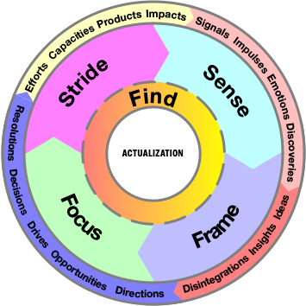
Set yourself up for sustainable, outsized impact
Get to know yourself and the world better
Collective actualization is your actualization
Make it easy to understand and adapt your thinking
Engage multiple identities and meaning-making

Slide 4
1. Delete me
2. Screenshot this slide!
3. Post to Twitter and Instagram using hashtag #MyActualizationFlywheel
I make outsized scalable impact by …
<core activity>
I get to know myself and the world better by …
<core activity>
I make it easy to understand and adapt my thinking by …
<core activity>
I bring purpose and intentionality to life by …
<core activity>
I engage multiple identities and find new meaning by…
<core activity>

Slide 5
1. Delete me
2. Screenshot this slide!
3. Post to Twitter and Instagram using hashtag #MyActualizationFlywheel
Note: “Added” and “Lost” are periodic metrics (depending on how you track results. “Total” refers to your grand total.
<Core metric>
Added: |  | Lost:
Total:
<Core metric>
Added: |  | Lost:
Total:
<Core metric>
Added: |  | Lost:
Total:
<Core metric>
Added: |  | Lost:
Total:
<Core metric>
Added: |  | Lost:
Total:

Slide 6
Instructions
List out the forces that move your experience through the flywheel. We’ve listed examples for you in each section.
Describe whether they are designed to serve your actualization needs or social normalization.
Update each force so it maximizes your authenticity and potential.

Slide 7
Sensing Forces
Force | Currently … | To maximize actualization …
Journaling | Haphazard without structure | Regular notifications with prompts and templates I can choose

Slide 8
Framing Forces
Force | Currently … | To maximize actualization …
Ideating | Kept in a single note, visited as needed | Kept in separate notes, reviewed periodically

Slide 9
Finding Forces
Force | Currently … | To maximize actualization …
Vision setting | Around big life events or annual, happy path only | Start at the outset of a project, add alternative scenarios

Slide 10
Focusing Forces
Force | Currently … | To maximize actualization …
Deliberate practice | Using a habit tracker | Add session-based work

Slide 11
Striding Forces
Force | Currently … | To maximize actualization …
Professional maturation | Based on current employer’s grading system | Correlated to personal and professional impact

Slide 12
List your current forces by the stage of the flywheel they’re currently optimized for.
“Sense” forces
“Stride” forces
“Focus” forces
“Frame” forces
“Find” forces

Slide 13
1. Delete me
2. Screenshot this slide!
3. Post to Twitter and Instagram using hashtag #MyActualizationFlywheel
Re-align forces so they are optimized for actualization.
“Sense” forces
“Stride” forces
“Focus” forces
“Frame” forces
“Find” forces

Slide 14
Instructions
Identify your points of friction.
What can be automated?
For friction points that can’t be smoothed with automation, what can be addressed through shared goals?
If shared goals won’t resolve the points of friction, what can be addressed through team reorganization?

Slide 15
1. Delete me
2. Screenshot this slide!
3. Post to Twitter and Instagram using hashtag #MyActualizationFlywheel
Source of friction | Can we fix this with …
 | automation? | a new goal? | reorganization?

